Slide 1
INCOME PREDICTION CHALLENGE FOR AZUBIAN
GROUP SYNDEY

Slide 2
Group Members
David Anifowoshie
Gideon Dadzie
Fredrick Kwabena Boateng
Williams Elikplim George
Efobi Godwin

Slide 3
INTRODUCTION

Slide 4
Within the context of developing nations, the stark imbalance in income distribution has assumed a prominent position, shrouding the future in a veil of ambiguity. Today, as we delve deeply into the core of this pivotal concern, we extend an invitation to you to join us on a voyage of discovery and pioneering solutions.
Our objective is unequivocal: to create a machine learning model with the ability to forecast an individual's income status, be it surpassing or falling below a specified threshold. This model will act as a guiding light, illuminating the path towards a future where we can address income inequality with precision and unwavering determination.

Slide 5
Project Structure
Business Understanding
Data Understanding
Data Preparation
Modelling
Evaluation
Deployment (using FastAPI)

Slide 6
DATA LOADING & DATA PREPROCESSING

Slide 7
The two essential datasets (train and test dataset) for this project was acquired on https://zindi.africa/competitions/income-prediction-challenge-for-azubian.
We employ the relevant libraries such as Pandas to import the data into our machine learning environment which facilitates data manipulation and exploration.
To understand the data better, we also include a variable definitions dataset that provides insights into the meaning of each variable. It acts as a reference guide for data exploration and feature engineering.

Slide 8
Once the data is securely in our grasp, the next crucial step is data preprocessing. At this stage, the following activities were performed,
Handling Missing Values
Feature Engineering
Data Type Conversion
Class Imbalance
NaN Value Analysis
Validation Split
Data loading and preprocessing served as the foundation for our predictive machine learning journey.

Slide 9
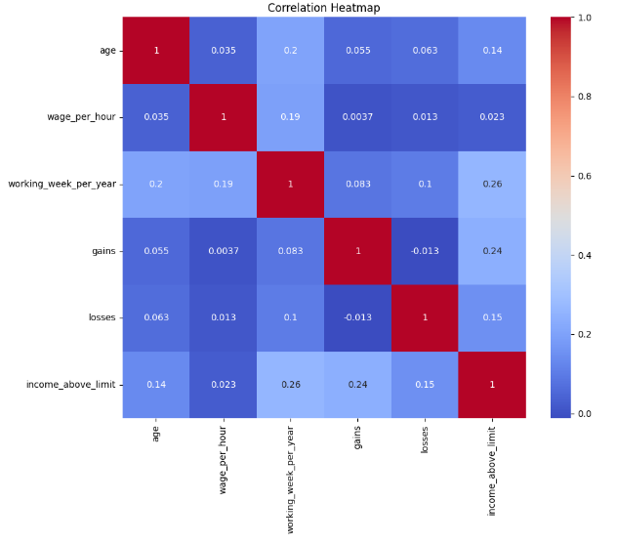
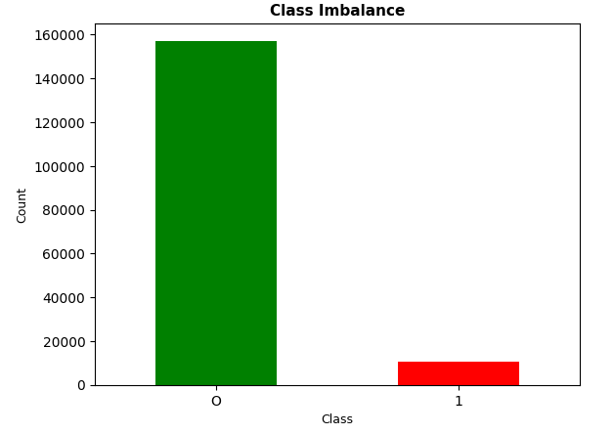

Slide 10
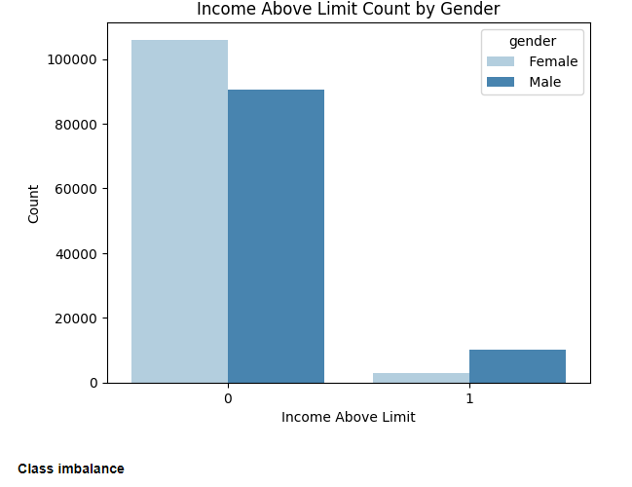

Slide 11
MODELLING AND MODEL EVALUATION

Slide 12
Model Selection
The heart of our project lies in choosing the right machine learning model to achieve our objective. For this purpose, we have opted for the CatBoostClassifier, a powerful algorithm well-suited for classification tasks.
XGBoostClassifier : We selected this model due to its remarkable capabilities in handling categorical features, implicit handling of missing data (NaN values), and quick establishment of a baseline model with minimal preprocessing.
Parameter Tuning: While adopting CatBoost, we also paid close attention to parameter tuning. Key parameters such as ‘n_estimators’, ‘max_depth’, ‘reg_lambda’, ‘reg_alpha’, ‘scale_pos_weight’, and ‘learning_rate’ were thoughtfully adjusted to optimize model performance.

Slide 13
Model Evaluation
Evaluating Accuracy: Our evaluation process commences with the computation of our model's accuracy on a validation set. This initial assessment offers a fundamental gauge of how correctly our model performs overall.
Classification Reports: To gain deeper insights into our model's effectiveness, we make use of classification reports. These comprehensive reports unveil vital performance metrics, including precision, recall, and the F1-score, for both the training and validation datasets. In situations marked by class imbalance, these metrics provide valuable insights into our model's capacity to accurately classify the minority class.

Slide 14
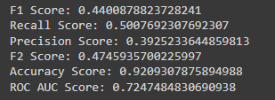
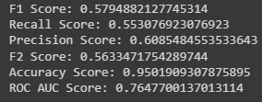
TreeClassifier Classification
XGBoost Classification Report

Slide 15

Fine-Tuning Thresholds: Recognizing the complexities presented by imbalanced data, we adopt a distinctive strategy. We adjust the probability threshold, optimizing the F1-score—a metric of relevance to our project. This adjustment enables us to enhance our model's performance, particularly in accurately classifying the minority class.

Slide 16
APP DEPLOYMENT

Slide 17
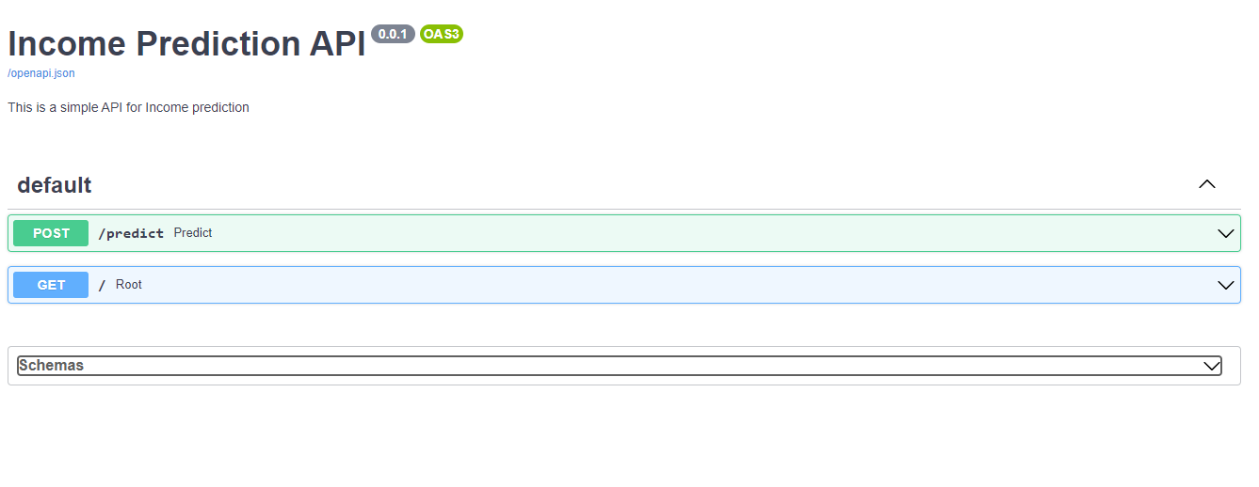
At this stage, having gone through all the above stages, we created an API

Slide 18
THANK YOU

